Slide 1
Resolution in propositional logic
Ciurcău Leonardo-Iulian
Group 911

Slide 2
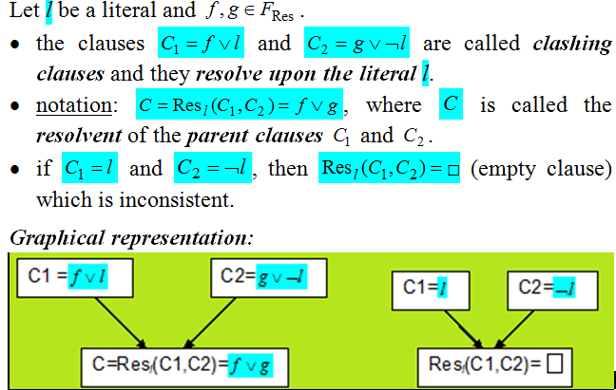
THEORY

Slide 3
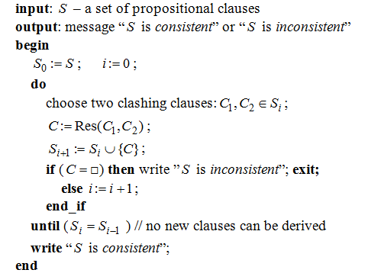
RESOLUTION ALGORITHM

Slide 4
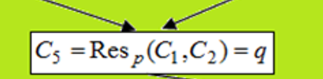
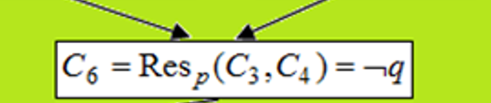

REFUTATION
When resolution is used to prove inconsistency, it is called refutation.
The binary tree from below, showing resolution and resulting in the empty clause, is called a refutation tree.

Slide 5
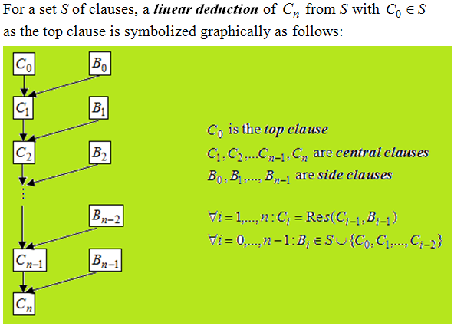
LINEAR RESOLUTION

Slide 6
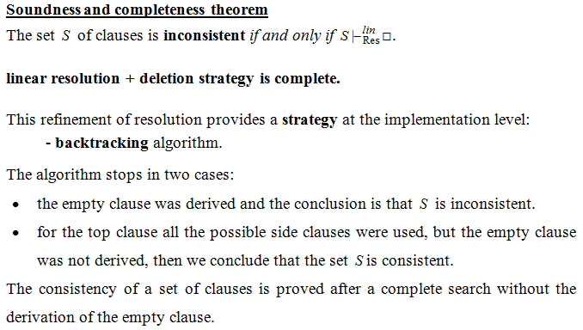

Slide 7
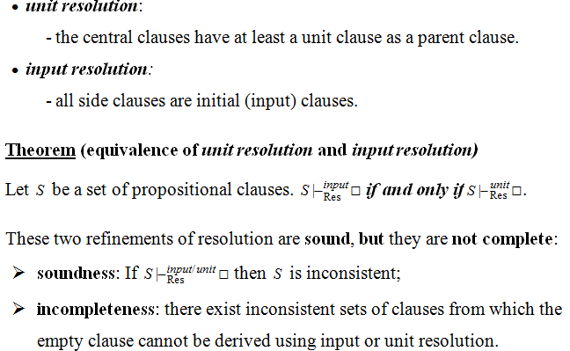

Slide 8
Exercise 4.1
Build a linear refutation from the following set of clauses:
The clauses from S1 can be written as following:
C₁ = p v q v r
C₂ = ¬q v r
C₃ = ¬r
C₄ = ¬p v r

Slide 9





Initial clauses : C₁ = p v q v r, C₂ = ¬q v r, C₃ = ¬r, C₄ = ¬p v r
C₁= p v q v r C₂= ¬q v r, C₃= ¬r, C₄= ¬p v r
C₅ = Res_{q}(C₁, C₂) = p v r C₅ = Res_{q}( C₁, C₂) = p v r C₃= ¬r, C₄= ¬p v r
C₆ = Res_{r}(C₅, C₃) = p C₆ = Res_{r}(C₅, C₃) = p C₄= ¬p v r
C₇ = Res_{p}(C₆, C₄) = r C₇ = Res_{p}(C₆, C₄) = r C₃= ¬r
C₈ = Res_{r}(C₇, C₃) = □ C₈ = Res_{r}(C₇, C₃) = □
Seeing as every side clause is an initial (input) clause, this linear refutation is also an input refutation.

Slide 10
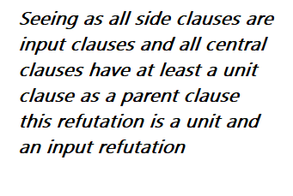
C₁ = p v q v r C₃ = ¬r C₂ = ¬q v r, C₁ = p v q v r, C₄ = ¬p v r
C₂ = ¬q v r
C₃ = ¬r C₉ = Res_{r}(C₃, C₂) = ¬q C₁ = p v q v r
C₄ = ¬p v r
C₉ = Res_{r}(C₃, C₂) = ¬q C₁₀ = Res_{q}(C₉, C₁) = p v r C₃ = ¬r, C₄ = ¬p v r
C₁₀ = Res_{q}(C₉, C₁) = p v r
C₁₁ = Res_{r}(C₁₀, C₃) = p C₁₁ = Res_{r}(C₁₀, C₃) = p C₄ = ¬p v r
C₁₂ = Res_{p}(C₁₁, C₄) = r
C₁₃ = Res_{r}(C₁₂, C₃) = □ C₁₂ = Res_{p}(C₁₁, C₄) = r C₃ = ¬r
C₁₃ = Res_{r}(C₁₂, C₃) = □

Slide 11
Conclusion
Using the linear resolution algorithm, we can obtain an empty clause, which proves that the set S1 is an inconsistent set, so the two linear resolutions are also linear refutations.
The first one is an input refutation because every side clause is an input clause.
The second one is an input and a unit refutation because every side clause is an input one and every central clause has at least a unit clause as a parent one.

